Slide 1
End User Computing
BICT 1101
Lecture 1: Using the Computer and Managing Files

Slide 2
Topics
Getting Started with Windows and Linux
Menus, commands and dialogue boxes
The start Menu and Taskbar
Working with Folders
Working with Files
Windows and Linux Applications
Customizing the Desktop
Printing

Slide 3
INTRODUCTION
Know what a computer is.
Learn how to use a computer – basic skill needed.
A computer is a system of components
  Input data and display output i.e. Input and Output devices;
  Processing unit called the Central Processing Unit (CPU) and
  Memory space which can be Read Only Memory (ROM) or Random Access Memory (RAM).

Slide 4
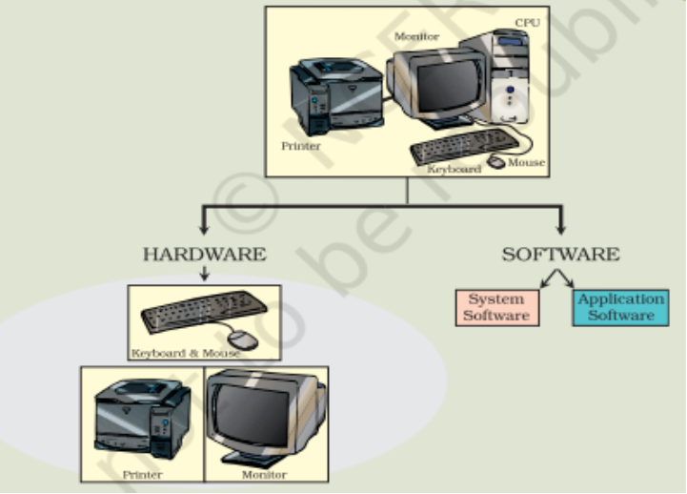
CONT…
COMPUTER SYSTEM
A computer system is usually defined as a combination of hardware and software.
Computer hardware is the physical and visible components/equipment while software is the collection of programs or set of instructions that make the hardware do its job, perform a specific task.

Slide 5
CONT…
HARDWARE
In order to accomplish a particular task the computer performs a series of jobs, namely, Input, Storage, Processing and Output, which it handles in a very special way as follows:
  It accepts the data (input) from the user.
  The computer has memory chips, which are designed to hold data until it is needed.
  It processes this data into information. The computer has an electronic brain called the Central Processing Unit, which is responsible for processing all data into information according to the instructions given to the computer.
  It then returns the processed information (output) to the user.
For performing each of the jobs listed above, every computer has special parts/components, for Input Device (Keyboard, Mouse), Storage Device , Central Processing Unit and Output Device (Monitor, Printer).

Slide 6
CONT…
SOFTWARE
It is divided into two main categories
  System Software – runs the computers hardware and application software and make the computer system available for use (acts as an interface between hardware, application software and the user).E.g. Operating System, Device driver, programming software, etc.
  Application Software – a computer program that provides users with tools to accomplish a specific task. E.g. Microsoft Office- Word processing, Spreadsheets, Presentation, Database management, LibreOffice, Accounting, VLC, etc.

Slide 7
CONT…
An Operating System (OS) is a program that acts as an interface between a computer user and computer hardware and controls the execution of all kinds of programs.
It is a software which performs all the basic tasks like file management, memory management, process management, handling input and output, and controlling peripheral devices such as disk drives and printers.
Some popular Operating Systems include Windows Operating System, Linux Operating System, iOS, etc.

Slide 8
CONT…
Following are some of important functions of an operating System.
  Memory Management
  Processor Management
  Device Management
  File Management
  Security
  Control over system performance
  Job accounting
  Error detecting aids
  Coordination between other software and users

Slide 9
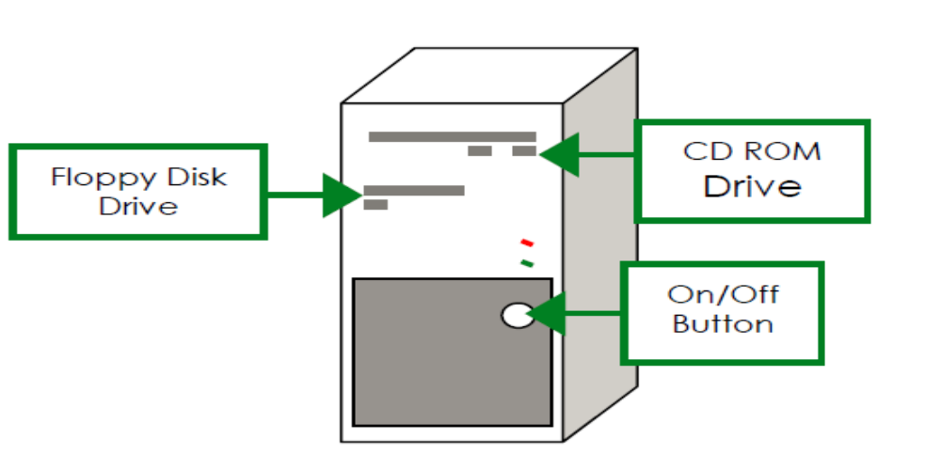
GETTING STARTED WITH WINDOWS AND LINUX
Turn on your computer
  The computer turns on by pressing the power button which is located on the computer case.
  To switch/turn on your PC, press the big round button (power button) located on the computer case. You may also need to switch on the monitor (screen) by pressing its big round button.
  Once your PC has started up, if necessary you will be asked to enter a username and a password. Once you have entered the correct password, you will see the desktop.

Slide 10
CONT…
To switch off your pc, click on the “Start menu” button, then select “Power”, then select “Shut Down”.
You will then be given the following options to choose from a drop down menu:
  Log Off
  Sleep
  Shut Down
  Restart
You could also choose to log off, to let another user access their files, or to restart the PC from this menu.

Slide 11
CONT…
The Start menu is the starting point of the system. Some of the things done through this menu include:
  Access programs
  Open frequently used folders
  Configure settings on the computer
  Access the Help function
  Shut down the computer
  Put the computer to sleep mode
  Restart the computer
Correct procedure for turning off the computer:
  The computer shuts down via Start menu, by clicking the Shut Down button

Slide 12
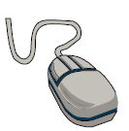
USING THE MOUSE
There are two buttons on the mouse that you will use regularly.
The first button is the left button. This is the button which you will use most regularly. The left button can be clicked once, or quickly twice, which is known as double-clicking.
Clicking the left button once will select whichever icon you click on. It is also the button you will use when resizing windows, pictures and text boxes.
Double-clicking allows you to open files and folders, and start up applications from your desktop.
The second button is the right button. Right clicking on a folder or file will show you a menu of options of tasks that you can do
with the file/folder.

Slide 13
THE DESKTOP
The Desktop is the first screen you see when your computer has started. It can be customized to look how you want and make it easier for you to do your work.
Each desktop look a little different.
Almost each and every Desktop screen has got:
  Icons
  Background
  Start Button
  Task Bar
  Quick launch Area
  System Tray
  Clock, etc.

Slide 14
CONT…
Taskbar
It is a black bar located at the bottom of your display screen when computer is in use. It’s location and other settings can be changed by right clicking on the taskbar then clicking on “Taskbar Settings”.
It allows one to easily locate and launch apps, view programs that are currently open, search from the computer, access notifications, access system and network shortcut. Also provides a way of switching between open applications.
Elements of a taskbar include:
  Start menu button – also known as the windows button, located on the left end of the taskbar.
  Search bar – Found on next to the start button. Used to quickly find files or apps on the computer.

Slide 15
CONT…
  Task View button – Found right next to the search bar. It displays all open windows on the computer and allows one to switch between them. Clicking the task View button also allows one to create and switch between multiple workspaces.
  Quick launch area – this is the wide space in the middle of the taskbar. This region accommodates program and application shortcuts. It provides quick access to applications on your computer. It can be customized by pinning/adding and unpinning/removing apps from the taskbar. To pin an app to the taskbar, simply right-click on the app on the desktop and select “pin to taskbar”.
  System Tray/Notification Area – Contains the date, clock and icons for some of the programs running in the background. Can be used to change some of the computer settings and also provides information e.g. whether you have a certain software in use or when using laptop it shows when battery is low.

Slide 16
CONT…
Windows Search Box/Pane
It is found next to the start menu.
It allows to execute searches on the internet, in windows.
After typing in your search text, press enter to open the highlighted program or file in the search results.
Background
Changes the color and pattern of the desktop.
This can be customized to anything you like e.g. your picture.

Slide 17
CONT…
Using the Help function
Windows 10 has a “Get Help” application that provides solutions to most problems.
The Get Help app is located in the start menu. You can either:
  Type “Get Help”, in the search box and when “Get help” appears click “Open”or press enter.
  Click the start button, scroll through the list of applications at the left side of the start menu and click “Get Help” shortcut.
Clicking on the Get Help app connects one to a virtual agent, which tries to find answers to what you have asked for by typing.
You can also press “F1 key” on your keyboard for help.

Slide 18
CUSTOMIZING THE DESKTOP
GENERAL INFORMATION AND ADJUSTING COMPUTER SETTINGS
System Information
  Click the Windows Start menu/button → click on settings (gear icon) → In settings menu, click on system then scroll down and click About. From this screen you will be able to view your system information/specifications (processor, memory and other information.
  Use the search box → type control panel in search box → open control panel and select System and Security → click on System.
Date and Time
  To change the time and date you need to right click on the Date and Time button found on the right corner of the taskbar at the bottom of the screen.
  Click “Adjust date/time” settings in the window opened.

Slide 19
CONT…
Speaker Volume
  In order to change the speaker volume, you need to click on the icon in the notification area on the right corner of the taskbar.
  By moving the vertical scroll bar, you can change the volume. Clicking the Toggle Mute button turns off the sound.
  You can also use keys on your keyboard.

Slide 20
CONT…
Desktop Background/Wallpaper
This is a picture you can have on your desktop background.
The appearance of your desktop background/wallpaper can be changed in the following manner:
  Right click on your desktop and chose personalize. Then click on background, click the drop-down list to chose a picture or color to cover your background with. Or
  Click the Start menu button, then click on Settings then click the Personalization icon.
  Click save after setting your background for changes to take effect.

Slide 21
CONT…
Screen Saver: Modifies what will come on the screen when your PC has been inactive for a set amount of time.
It protects your computer (if you do not want people to use your computer while you are away from your desk then you can specify a password that must be entered to clear the password).
To set a screen saver:
  Click on personalization icon, then click Lock screen followed by clicking the Screen saver setting link.
  Under Screen saver, use the drop down menu and select your preferred screen saver.
  The “Wait” option lets you set the number of minutes of inactivity before the screen saver turns on.
  Click Apply button then OK button.
***** Explore other things in Personalize, including password setting ******

Slide 22
CONT…
Resolution: If you are having difficulty seeing your computer display you might want to change the screen resolution.
How well your computer screen displays depends on its resolution.
Resolution is measured in pixels. If you look closely to your computer screen you can see that it is made up of lots and lots of dots, or pixels.
If you change the number of pixels per square inch that your computer displays, you will change the size and quality of display.
  To change the screen resolution, Click the Start menu button, then select the Settings icon, select System, click Advanced display settings. Then click on the menu under Resolution and select your desired option.
  It is strongly advised to select the one that ha recommended” next to it. Then click apply

Slide 23
CONT…
Control Panel
  The Control Panel is a special folder in which you can adjust the system settings through various system setting options (adjust the keyboard, mouse, sound and so on) uninstall programs, which can be viewed by category or in the form of small/large icons
  The Control Panel can be accessed by typing in the search box, type “Control panel” then select the result.
  Press Windows + R to open the Run dialog, type Control Panel in the empty box and click OK.

Slide 24
CONT…
Selecting and adding the keyboard language
  Click the Windows start menu, settings then click on “Time and Language”, followed by a click on “Language” in the left sidebar.
  Under “Languages” click “Add a language”.

Slide 25
PROGRAM MANAGEMENT
Installing new programs:
  From CD, DVD, USB flash drive, Internet, Network
  When installing from a USB flash drive, CD or a DVD, in most cases a dialog box will automatically open up from which the Run AutoRun.exe option can be selected to start the Setup Wizard.
  If the installation of the program does not start automatically, you can start the installation manually by double-clicking on the file typically called Setup.exe or Install.exe.
  After the Wizard installation has started, follow instructions and go to next steps by pressing the Next, Yes, and other such buttons. You will usually have to accept license terms, choose a location where the program will be installed, possibly choose components of the program you want to install etc. At the end press the Finish or Close button.
Uninstalling the programs
  In the Control Panel, click on the Programs or Uninstall a program, then select the software you want to uninstall by right clicking it and click the Uninstall option.

Slide 26
ICONS
Icons are small pictures (pictograms) on a computer screen and they all represent programs, folders, files and shortcuts (applications and tools) available on your computer.
  Clicking on an icon will select it – there is a color change.
  Clicking away from the icon will deselect it – what happens to the color?
  A double-click on a program icon will open and start the appropriate program.
  A double-click on the folder icon will open a window that shows files and folders contained in that folder.
  A double-click on the file icon will start the appropriate program and open that file in the appropriate program.

Slide 27
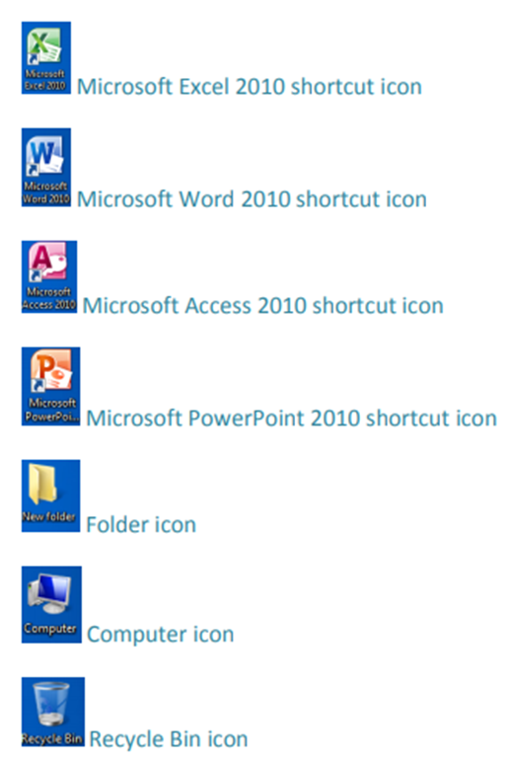
CONT…
ICON EXAMPLES

Slide 28
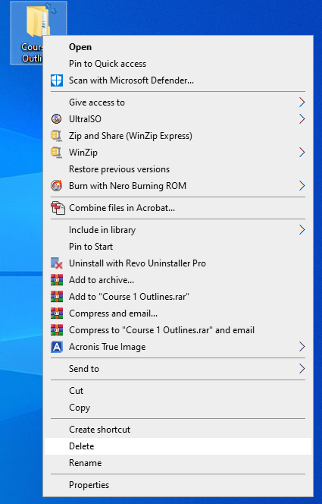
CONT…
  Right clicking on an icon will give you a menu of options to choose from.
  Left clicking on an option from the menu will select that option, and start the appropriate task e.g. deleting a folder.

Slide 29
CONT…
Selecting and Moving (one or more) Desktop Icons.
Just as you rearrange your study table, you can also rearrange your computers desktop.
An icon can be selected by clicking on it. To move an icon, click on an icon with the left mouse button and drag it. To select multiple icons at once:
  Single click the first icon you wish to select. Hold down the Ctrl key and using the mouse or trackpad click on all the other files or icons you wish to select one by one.
  Select an icon, press and hold down the Shift key, press the last icon in a row and release the Shift key (selecting consecutive icons), or
  Press and hold down the Ctrl + alt keys and select the non-consecutive icons using the left mouse button.

Slide 30
CONT…
Icons are moved via the drag-and-drop method – press and hold down the left mouse button over the icon, drag the mouse (with the icon) to a new location, and release the mouse button (which places the icon in the new location).
Arranging Icons
Windows 10 and other older versions of Windows can tidy up your desktop by automatically arranging the icons. This can be done by:
  Right clicking anywhere over your desktop then click on “view”, this brings different options about icons including auto arranging of icons.

Slide 31
CONT…
Desktop Shortcuts
Shortcuts are files that point to other programs, program files or folders found somewhere on the computer.
They are links to folders, programs, or document not the actual thing.
You can create shortcuts that allow you to open programs, folders, or documents that you use frequently. You can put a shortcut on your desktop.
Shortcuts always have a little curly arrow on the bottom left corner of the icon.

Slide 32
CONT…
  A double-click on the shortcut icon will start either the appropriate program, or the appropriate file and corresponding program, or appropriate folder.
Creating a shortcut on the Desktop
  Find the icon for the program, folder or document you want to create a shortcut for.
  Restore or resize the “This PC” window if your icon is coming from there, so that you can see the desktop as well.
  Click and drag the icon into the desktop then release the mouse a shortcut will be created on the desktop. OR
  Right click and drag the icon you wish to create a shortcut to into the desktop, a menu will appear. Click on “Create shortcuts here”. OR
  Right click on the item you wish to create a shortcut to, a menu will pop up. Click “Send To” then select “Desktop (create shortcut)” from the menu options.

Slide 33
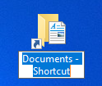
CONT…
Renaming Shortcuts: Because a shortcut just points to a document, folder or program (it is not the actual thing), it can be renamed without renaming the file. It can be renamed to anything you like. To rename the shortcut:
  Position your mouse over the shortcut you wish to rename.
  Right click on the shortcut. A menu will appear.
  Click “Rename”. The name of the shortcut is highlighted.
  Type the new name for the shortcut.
  Click away from the shortcut.

Slide 34
CONT…
Deleting Shortcuts: You might want to remove shortcuts that you no longer want. If you delete a shortcut it does not delete the original object (the item to which the shortcut is pointing). To delete a shortcut:
  Right click on the shortcut.
  From the pop up menu click “Delete”. The shortcut will be deleted.
  If a menu appears for you to confirm your action, click “Yes” to confirm it.

Slide 35
BASIC ACTIONS WITH WINDOWS
Every task you perform on your computer will open in a box called a Window. For example when you open word, a window appears on the screen containing the software. You then work inside the window.
You can have several windows opened at the same time, but only one will be active:
  The active window has a highlighted border and the inactive window is grayed out
  The opened window becomes active if you click on it, or
  The opened window becomes active if you click on its section. On the taskbar We can move windows using the drag-and-drop method:
    Press and hold down the left mouse button on the taskbar or title bar, drag the window to where you want to move it and release the mouse button.

Slide 36
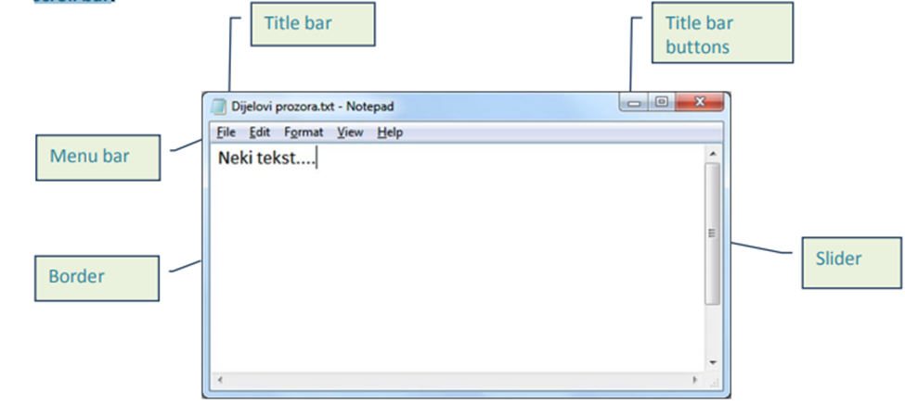
CONT…
Recognizing different elements of a window: title bar, menu bar, toolbars, status bar, scroll bar.

Slide 37
CONT…
Title bar: Shows the name of your document and the application you are working in.
Menu Bar: Provides a list of menus, each offering options for modifying your document.
Toolbar: Displays buttons which provide shortcuts for doing tasks within the application.
Status Bar: Displays where you are in your document (eg, page number, line number you are editing, language you are using).
Scroll Bars: Allow you to move up and down and along your document.

Slide 38




CONT…
Title bar buttons for manipulating the window are located on the upper right corner of the window’s title bar.
  The Minimize button – minimizes the window to the taskbar (makes it temporarily disappear).
  The Restore Down button - restores the window to the size before maximization
  The Maximize button - spreads the window over the entire desktop
  The Close button - closes the window

Slide 39
CONT…
Switching between Windows
  Click the window you require on the taskbar, then the window will appear on the screen.
Resizing Windows
  Ensure the window is restored – if the window is maximized or minimized you can’t resize the Window.
  Position the mouse cursor at the edge of the Window – mouse cursor changes.
  Click and drag

Slide 40
CONT…
Moving Windows
  Position the mouse cursor on the Title bar – mouse cursor changes.
  Click and drag to move the Window to a new position.

Slide 41
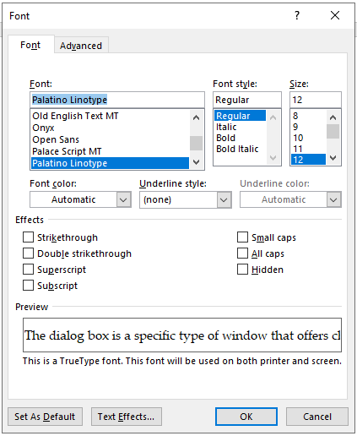
DIALOGUE BOX
A dialog box is a specific type of window that offers choices related to a certain task. E.g. confirming an action by clicking the OK button, or cancel it by clicking the Cancel button. Unlike regular windows, their size is fixed.

Slide 42
WORKING WITH FILES AND FOLDERS BASIC CONCEPTS
A folder is the common storage unit in a computer, and all programs and data are “written” into a file and “read” from a file.
  It is a set of digital data.
A folder provides a method for organizing files. It holds one or more files, and a folder can be empty until it is filled.
  It can also contain other folders, and there can be many levels of folders within folders known as Subfolders.
  Also known as Directory, and created on the hard drive (HD) or solid state drive (SSD) when the operating system and applications are installed.
  Example of a special kind of folder that displays its contents across the screen is the computers desktop

Slide 43
CONT…
A file is defined by a name and an a file format/an extension.
A file format is the way in which information is stored in a file so that a program can open and save the file.
When you save a document, each application will add a different three letter extension to the name of your document, so that you can tell at-a-glance in which application you have been working on that file.
The extension indicates the file type (text, multimedia etc.) and tells the computer which application is appropriate for that file type.
It is important that upon saving your document, you ensure that it will have the correct file ending, or it will not save properly. E.g. you will be unable to open a word document if you have saved it with a “.ppt” ending.

Slide 44
CONT…
File extensions of some frequently used files are:
  .exe – executable files
  .sys, .dll - system files
  .tmp, .temp – temporary files
  .rar, .zip, .7z – compressed files
  .jpg, .jpeg, .gif, .png– image files
  .mp3, .wav, .wma– audio files
  .avi, .wmv, .mpg, .mp4 – multimedia files
  .txt, .odt, .doc, .docx – text files
  .ods, .xls, .xlsx – spreadsheet files
  .odp, .ppt, .pptx – presentation files
  .dbf, .mdb, .accdb – database files
  .pdf – (Portable Document Format)
  .htm, .html, .asp, .aspx, .php – web pages

Slide 45
CONT…
Each file has a name, an icon (assigned by the operating system) and an extension.
Files are placed/stored within folders (for easier reference).
To browse computers for files and folders we use Windows Explorer/File Explorer.
  It displays a hierarchical view of folders and files.

Slide 46
CONT…
Searching for a File or Folder
If you are unsure of the location of a file or folder, you can use the Search Box facility to find it:
  By typing in the name or by typing in a key word that the file/folder contains.

Slide 47
CONT…
Introduction to Windows/File Explorer
Through Windows/File Explorer you can access all the files and folders stored on your computer and organize them by:
  Copying
  Moving
  Deleting
To access Windows/File Explorer, double click on either the “My Computer/This PC” or “Windows/File Explorer” icon on the Taskbar. If not on pinned on the Taskbar:
  Click on the start menu, click on all apps, the scroll to Windows System.
  Click on Windows System and then scroll to File Explorer.
    Right clicking on File Explorer will bring the option for more choices. If you scroll to more, you should see the option to pin to Taskbar.

Slide 48
CONT…
In Windows 10 it can also be opened by:
  Right clicking the Start button and then click on the File Explorer option. OR
  Press the Windows logo key + E on the keyboard. OR

Slide 49
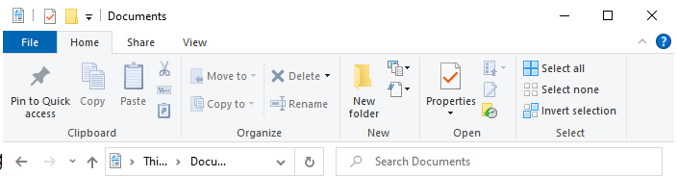
CONT…
Navigating File Explorer
File Explorer can be navigated using the Standard Toolbar.
To go back to the last screen you were working in, click the back arrow “←”
To see the drives and folders above the one you are currently looking at, click the upward arrow “ ”.
To search for a document type the document name in the “Search Box”.
Upward arrow
Backward arrow
Search Box

Slide 50
CONT…
Organizing Files and Folders
All files and folders on your PC are stored on disks, which are in located on drives.
Drives are named with letters of the alphabet.
Each device has an icon, name and letter in the parentheses (A, B, C, D, E,...). There can be one or more Hard Disk Drives on the computer, or there can be one HDD divided into partitions.
Devices used by the operating system for data storage are marked with capital letters (e.g. Floppy (A:) ; Local Disk(C:); Removable Disk(E:) etc.) and are available in My Computer/This PC.
Examples of common uses for drives are:
  A Drive: Floppy Disks
  C Drive: Local Hard Drive/Disk
  D Drive: CD ROMs
  E Drive: Removable Disk
  F Drive: USB

Slide 51
CONT…
Why is it necessary to make additional copies of important files on removable storage devices?
It is recommended to create back-up copies of important files in case the original files become inaccessible, either due to drive failure, accidental deletion or other reasons.
If you have a backup, you can restore original files. Backup is done mainly on removable storage devices.
The advantages of storing data on network devices
If the computer is connected to a network, you can access shared data (shared with other users on the network).
To access network disks, open the Network Places folder usually found on the desktop or within the Start menu. (File Explorer, Click Network from the left pane, here you can see shared computers, printers and other resources on the network.)

Slide 52
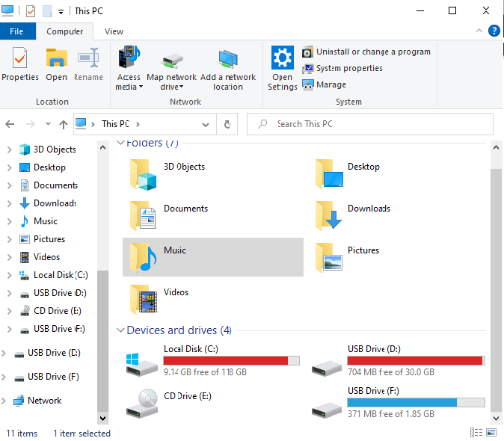
CONT…
To navigate your way round Windows/File Explorer, click on the drive you want. This will enable you to see the contents of the drive on the right hand section of the window.
Within each drive is a structure
of folders. Each folder contains
files, and some folders also contain
sub-folders, which in turn may
contain further files and sub-folders.
By clicking on a folder, the
documents and sub-folders
contained in each drive or folder
will appear on the right hand section of the window.

Slide 53
CONT…
Viewing Files and Folders in Windows Explorer/ File Explorer
There are three common ways to view files and folders in Windows/File Explorer:
  As icons
  In a list
  In a list with their properties displayed (eg author, date created)
To change this, go to the “View” button on the Standard Toolbar, and select the appropriate view from the “Layout” group.
If you have the files and folders displayed as a detailed list, there are several different ways you can organize this list:
  By Name
  By Size
  By Type
  By Date modified, etc.

Slide 54
CONT…
To organize files and folders by any of these methods, click on the “view” button then “Sort by” in the “Current view” group.
In our example below, the “Name” option has been selected, and files and folders are displayed by their Name, in alphabetical order (Ascending):
  Folders
  PDF documents
  Dropbox file
  PowerPoint documents
  Word documents

Slide 55
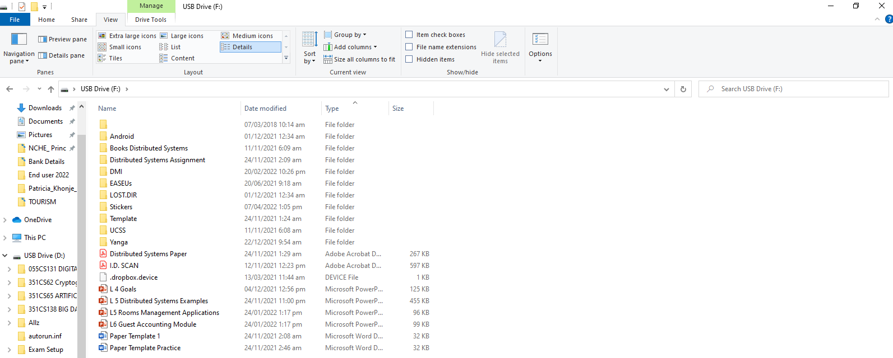
CONT…

Slide 56
CONT…
Libraries
Libraries help users organize their files and folders efficiently, together in one place regardless of where they are stored.
In Windows 10 there are six default libraries:
  Camera Roll - it is used for organizing and saving pictures.
  Documents - this library is used for organizing and saving documents (text files, workbooks, presentations etc.)
  Music - it is used for organizing and saving music
  Pictures - it is used for organizing and saving pictures
  Saved Pictures - it is used for organizing and saving pictures
  Videos - it is used for organizing and saving video materials
Each file and folder have its path – an address of its location.
Above figure shows an Address Bar – Path to the Sample Music folder

Slide 57
CONT…
Creating Folders
Folders can be created directly into a drive, such as the C (Local disk) Drive, or within a folder which already exists.
To create a folder:
  Locate the appropriate drive and/or folder you wish to save in to
  Go to “Home” tab
  In the “New” group
  Click the “New Folder” option
  The new folder will come with a default name of “New Folder”. You will need to rename it to the name of your choice.
  Type the name of your choice and press enter or click away from the folder.
You can also create a folder by:
  Pressing “Ctrl + Shift + N” at the same time while in the location where you want to create the new folder.

Slide 58
CONT…
Selecting Multiple Files or Folders
To select a single file, simply left-click on it once.
To select a group of adjacent files or folders:
  Select the first file/folder
  Hold down the [Shift] key
  Select the last file/folder
To select a group of random files:
  Select the first file/folder
  Hold down the [Ctrl] key
  Select each of the other files/folders individually

Slide 59
CONT…
Copying Files or Folders
Copying and Pasting
Files and folders are copied and pasted when you wish to keep the file/folder in the same place, but also have another copy elsewhere.
To copy and paste a file/folder:
  Right click on the appropriate file/folder
  From the pop up menu click “Copy”
  Find the new folder you wish to add the file/folder to
  Right click on the folder you wish to add the file/folder to
  From the pop up menu click “Paste”
To copy and paste a file/folder using shortcut keys:
  Select the file or folder you wish to copy from its location.
  Press “Ctrl + C” on the keyboard at the same time.
  Then while in the new location you want to place your file or folder press “Ctrl + V” on your keyboard.

Slide 60
CONT…
Copying using the drag-and-drop method:
  Select the file/folder you want to copy
  Over the selected file/folder, press and hold down the left mouse button, and then drag the mouse pointer (with file or folder) to a new location.
  Release the mouse button. The file or folder will be pasted to the new location. OR
  If copying in the same location e.g. on the desktop using the drag and drop method.
    As you holding the left mouse button also press the “Ctrl” key on the keyboard and release it as you are releasing the mouse button at the desired location.

Slide 61
CONT…
Moving a file or folder
Files and folders are moved when you wish to permanently change the place where they are stored. To move a file/folder:
  Right click on the appropriate file/folder
  Select “Cut” from the pop up menu options.
  Find the folder you wish to move the file/folder to
  Right click on the folder you wish to move the file/folder to
  Select “Paste” from the pop up menu options.
Moving file using shortcut keys:
  Press the “Ctrl + X” keys on the keyboard then “Ctrl + V” keys in the desired location where you want to move your file or folder to.
Moving file using drag and drop method
  use the same steps as for copying, except without using the Ctrl key if moving in the same location.

Slide 62
CONT…
Renaming a file/folder:
To rename a file or folder
  Right-click on the file/folder and from the pop-up menu, select the Rename command. Type in the new name and press the left mouse button next to the icon or just press Enter.
  Select the file/folder and after a few moments press the left mouse button then type in the new name and press the left mouse button next to the icon or just press Enter.
Deleting a file or folder:
Once you have finished with a folder or file, you can delete it:
  Right click on the appropriate file/folder
  Select “Delete”

Slide 63
THE RECYCLE BIN
The Recycle Bin is where any folders or files that you decide to delete go. They stay there until you choose to “empty” the Recycle Bin. This means that if you accidentally delete a file or folder, you should be able to retrieve it, and send it back to the place it was originally located.
Delete files and folders by moving them into the Recycle Bin: via File Explorer:
  In the navigation pane select the location the files/folders you want to delete are in, then in the right window select the files/folders you want to delete and click the “Home” tab and from the “Organize” group on the toolbar, choose “Delete”, or
  Press the right mouse button over the file/folder and from the pop-up menu, choose Delete
  Select the file/folder you want to delete and press the Delete key on the keyboard.

Slide 64
CONT…
Delete files and folders by moving them into the Recycle Bin: via the drag-and-drop method (on the Desktop):
  Press and hold down the left mouse button over the file/folder/shortcut you want to delete, then drag the mouse cursor to the Recycle Bin and release the mouse button
To Restore deleted items from the Recycle Bin:
Deleted items (files/folders/shortcuts) can be restored from the Recycle Bin to their original location on the computer prior to deletion.
There is also an option to restore everything in the Recycle Bin at once.

Slide 65
CONT…
After opening the Recycle Bin (by double-clicking on the Recycle Bin icon) use the following commands on the toolbar:
  Restore all items – restores all items from the Recycle Bin to their original location on the computer
  Restore this item – to make this command available, first select the file/folder you want to restore
Empty the Recycle Bin
You may wish to completely empty the Recycle Bin, if you are sure that you will not need to use its contents again.
  Via Recycle Bin window toolbar – the Empty the Recycle Bin command permanently deletes files/folders from the computer, or
  Right-click on the Recycle Bin icon found on the desktop and from the pop-up menu, choose the Empty Recycle Bin command

Slide 66
WORKING WITH FILES AND FOLDERS BASIC CONCEPTS
Common Keyboard Shortcuts
There are also ways to perform some operations, using the keyboard by pressing a combination of keys:
  Open: Ctrl + O
  Select all: Ctrl + A
  Save: Ctrl + S
  Copy: Ctrl + C
  Print: Ctrl + P
  Cut: Ctrl + X
  Find: Ctrl + F
  Paste: Ctrl + V
  Launch help: F1
  Undo: Ctrl + Z

Slide 67
TEXT EDITING APPLICATIONS
There are 3 different text editing applications supplied with Windows:
Notepad: Very basic text editing application which only allows you to choose different fonts to type in.
WordPad: Allows you to choose different fonts and colors and to align text left, right or center and insert bullets.
Word: The most advanced of the three. Allows you to modify most aspects of your document, including text alignment, font color, pictures, tables, tabs, bulleted lists and margins.
Opening WordPad or Notepad:
  Right click the “Start menu”
  Select “Apps and Features”
  Then select “Optional Features”
  Select the appropriate application whether WordPad or Notepad

Slide 68
CONT…
Opening Word:
  Click the “Start menu”
  Scroll down through the applications and select “Word”
  If pinned on Taskbar, click the word icon on the Taskbar.
Printing a text document from a word processing software:
  Go to “File” tab.
  Select “Print” option.
  This will bring up a new window, where you can enter details of how many copies, and which printer you wish to use.
  Once you have entered these details, click “Print”.

Slide 69
CONT…
Saving your document:
  Go to “File” tab
  Select “Save As”
  A new window will open.
  Give your document a name
The application you are working in will automatically pick a file format for you. However, you can choose to over-ride this by clicking on the dropdown arrow in the “Save as Type” box.
Within Notepad, you can save your document only as “Text only”.
WordPad will automatically select “Rich Text Format” for your document, however you can also save your document as “Text only” or a “Word document”.
Word will automatically select “Word document”, for your document, however, you can also save it in all of the above formats, as well as several others, such as a Web page (.html).

Slide 70
CONT…
What do they all mean?
Text only (.txt): This signifies that the document contains only text, no formatting. Select this format only if the destination program cannot read any of the other available file formats.
Rich Text Format (.rtf): Saves all formatting. Converts formatting to instructions that other programs, including compatible Microsoft programs, can read and interpret.
Word Document (.doc): Saves all formatting, but the document can only be opened up in Word.

Slide 71
PRINT MANAGEMENT
PRINTING AND PRINT MANAGEMENT
  Select a printer from the list of installed printers found in the Control Panel --> Hardware and Sound → Devices and Printers. If there are multiple printers, only one is set to default which is automatically used for printing unless specified otherwise.
  To view or modify any of your printer settings, install a new printer, pause, delete or restart print jobs, you go to Control Panel --> Hardware and Sound → Devices and Printers.
  This will open up a print management window, which has a list of all the printers you can currently access.
  Here you can change the default printer. Select the printer you want to set as default printer and right-click on it, and from the pop-up menu, select the Set as default printer command.
Installing /add a new printer to the computer:
  In the Devices and Printers window - on the command bar, choose Add a printer
  Use the installation CD provided with the printer when it was purchased.
  You will be taken through step-by-step instructions for how to install a printer.

Slide 72
CONT…
Changing the Default Printer
Within the print management window, one of the printers displayed will have a small tick as part of the icon. This means that this printer is the default printer – the printer that Windows will automatically print to unless told otherwise. To change this:
  Right click on the printer you wish to select as default printer
  Select “Set as Default Printer”
You will see that the tick has transferred to the printer you have selected.
Viewing, Pausing, Restarting and Deleting Jobs
Within the print management window, click on the printer you wish to access. On the command bar chose the preferred option which will bring up a new window , which will list all the print jobs which are currently queued for that printer, and what their status is, i.e. are they currently printing or paused.
To see what’s printing you can also right click the printer and from the pop up menu options choose the preferred option.

Slide 73
CONT…
To modify a job, right click on it. This will bring up a menu which will allow you to pause, restart and cancel a job. Simply select the option you require and Windows will carry out the action.
  To pause/stop the current document from printing, right-click over the document name in queue, and from the pop-up menu, select the Pause command.
  To continue printing the document, choose the Resume command.
  If you want to stop printing the document – in the pop-up menu, click on the Cancel command and confirm the action by clicking the Yes button.

